Slide 1


FARMING ON MARS
TEAM NAME :
DOMAIN :
TEAM MEMBERS :
KNOWLEDGE SEEKERS
SPACE SCIENCE
DR.S.DHIVYA
B.VIGHNESHWARA
C.KUMARAN
S.DHARSHAN

Slide 2

Suggest a constructive system for doing agriculture and cultivating food products on Mars
Introducing Cyano-bacteria in MARS which is able to convert CO₂ to O₂ in presence of H₂O and sunlight. And also produce C₆H₁₂O₆ which helps in change in texture in associate with EARTHWORMS we introduce in MARS.

Slide 3

INTRODUCTION
With respect to farming on Mars, the soil texture and atmosphere doesn’t suit for crop cultivation. Therefore, change in soil texture and atmosphere is required.

Slide 4
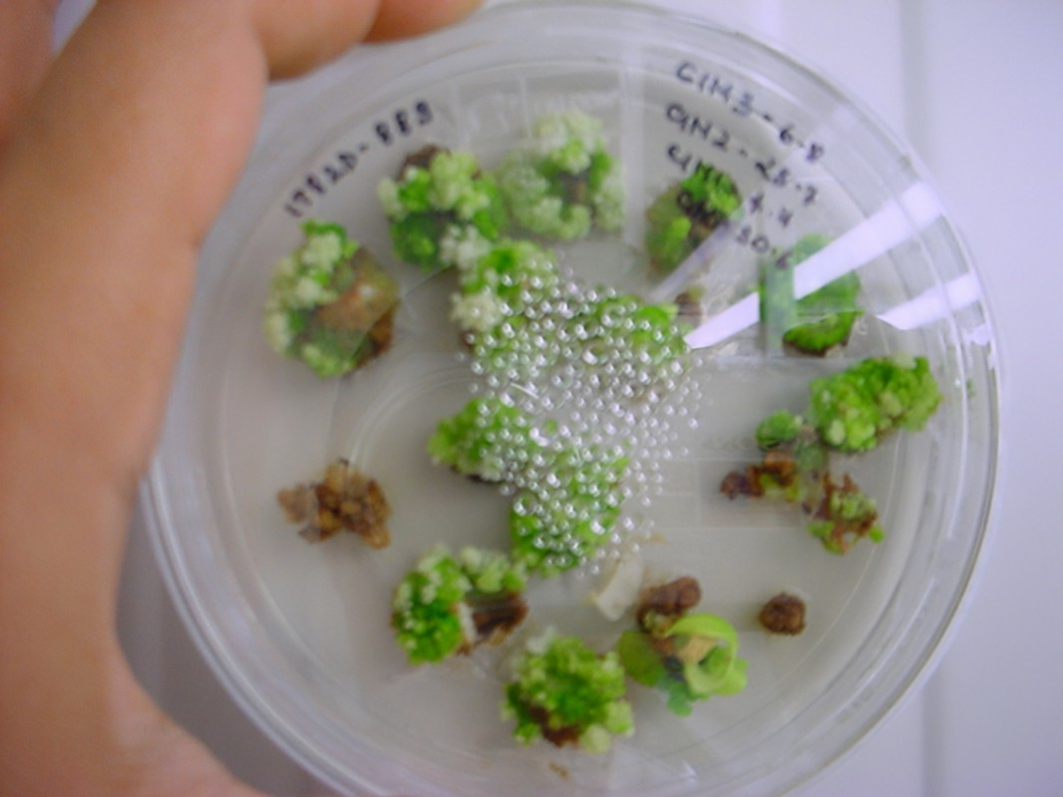
PREPROCESS
Introducing a Beneficial microbe, namely Cyano-bacteria after bio-technically sterile it, in order to stop mutation between generation gap in sexual reproduction, in the culture medium at Mars in laboratory conditions helps the microbe to adapt with Mars’ environment. As a part of minding that the microbes are able to mutate in to new atmosphere, we sterile the Cyano-bacteria to a condition of that it is unable to sexually reproduce.

Slide 5

CARRIAGE
The stocks taken to Mars are:
Bio-technically modified Cyano-bacteria,
Highly compressed water form (ice),
Culture medium for Cyano-bacteria.

Slide 6
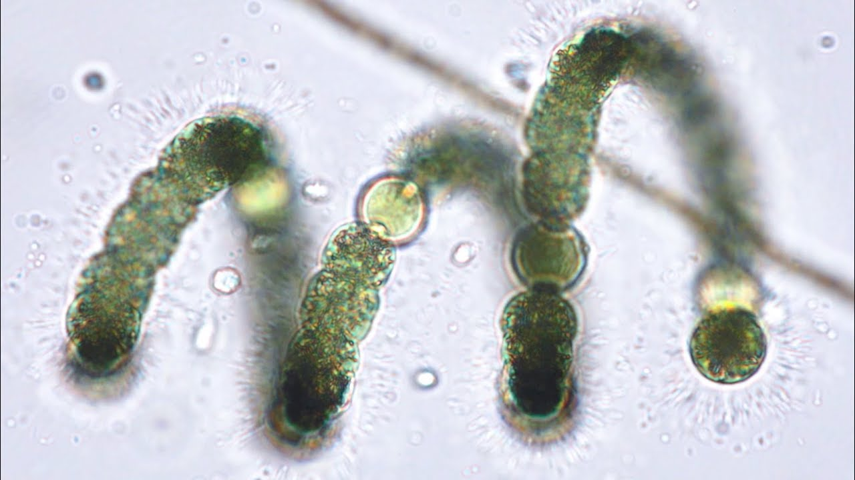
CONCEPT OF CYANOBACTERIA
After introducing the microbe to Mars environment, the combination of Cyano-bacteria, water and sunlight & CO₂ available on Mars, the microbe is able to convert the CO₂ to O₂ and form a by-product (C₆H₁₂O₆) and result in half-usage of water involved.

Slide 7

WATER SYNTHESIS
Thus the O₂ released in atmosphere flows out and raises up to the exosphere, and gets heat up by solar radiation and forms O₃ (ozone) bond, which traps heat in Mars’ atmosphere.
Surprisingly, this heat helps in melting of polar ice caps present in Mars which are made up of water molecules. Thus, the limiting agent, water, is also available in large amount now resulting in repetition of the cycle.

Slide 8


FERTILIZATION OF SOIL
Thus, it results in increase in O₂ level in Mars’ atmosphere and change in soil texture leading it a planet able for farming.
Addition of clay particles to Mars’ soil help crops to balance the low gravitational-force of Mars with crops.
The introduction of earthworms to Mars also helps in farming, by digesting the dead Cyano-bacteria to nutrients.

Slide 9

NANOBOTS
In case of unavailability of water, NANOBOTS can be used to degenerated polar caps and converted into liquid H₂O.
It can be used for cultivation of Cyano-bacteria.
And, it can also be used for other research purposes.

Slide 10

Cyano-bacteria
CO₂ to O₂ conversion
O₂ to O₃ @exosphere
O₃ traps heat
Increase in temp. melting polar ice caps

Slide 11

TECHNOLOGY USED
Biotechnology for sterilizing Cyano-bacteria.
Nanobots (in case of more H₂O requirement).

Slide 12
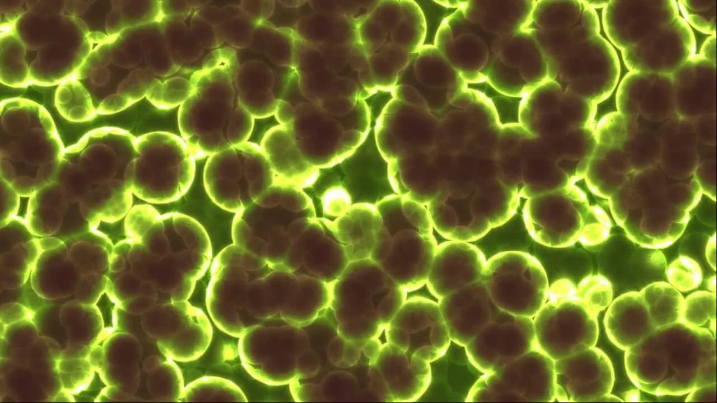
DISADVANTAGE
Although the microbe is sterilized to non-mutational level, its to stop mutation in between generation gap.
The probability of mutation in a single life span is more, but an advantage in its that the budding rate in Cyano-bacteria is more, which stops the mutation process in the single life span before its complete.

Slide 13
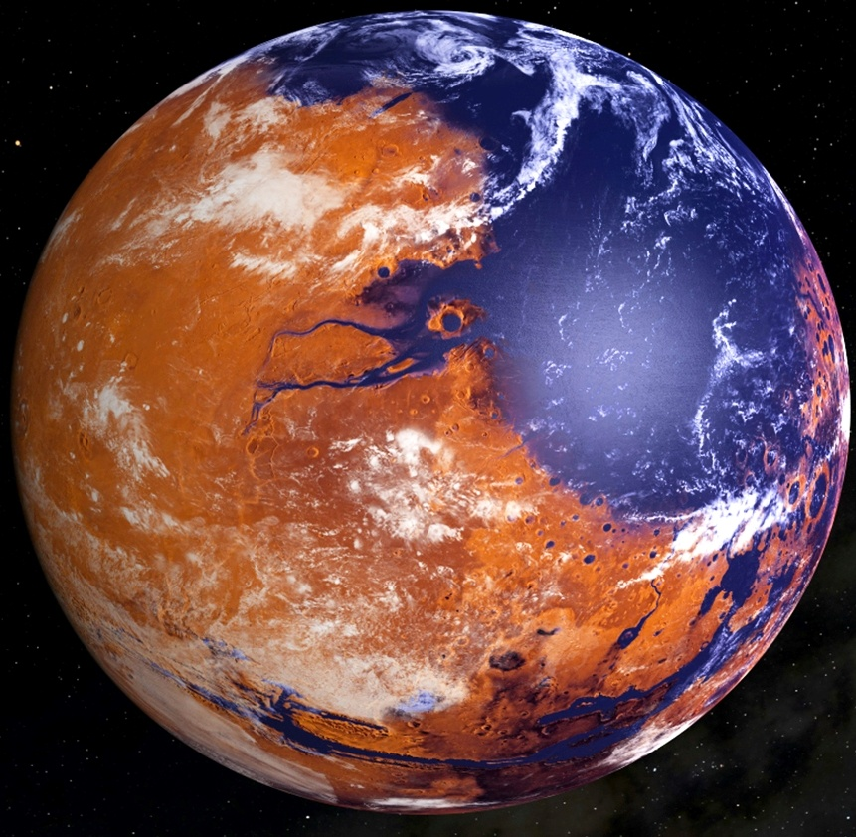
CONCLUSION
From this we can conclude that, by cultivating crops in MARS,
It will be a suitable planet for colonization of homo-sapiens and also other species.
“MARS COULD BE A NEW EARTH,
THE SECOND LIVING PLANET”

Slide 14

AND ALSO TO BE
CONTINUED…….

